Slide 1
A Bio-Inspired Jump-Gliding Robot
Team Sigma Tree
Zhang Zheng
Liu Lizhi
Xu Yukun

Slide 2
Jumping Moudule
Solution Selection
Dynamic Modeling
Release Mechanism

Slide 3
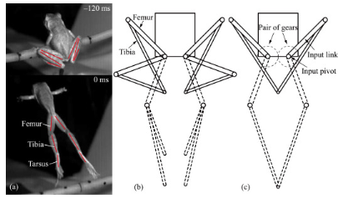
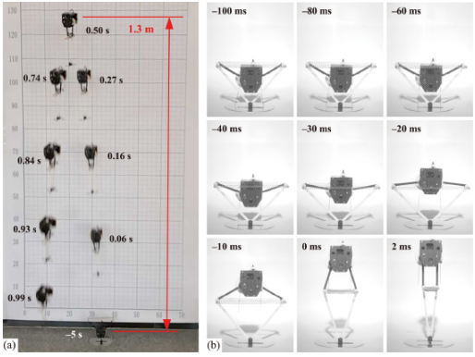
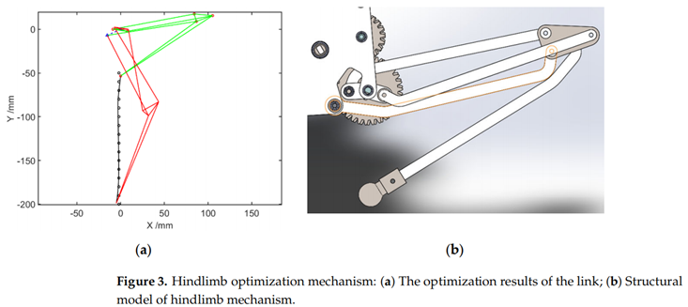
Solution Selection

Slide 4
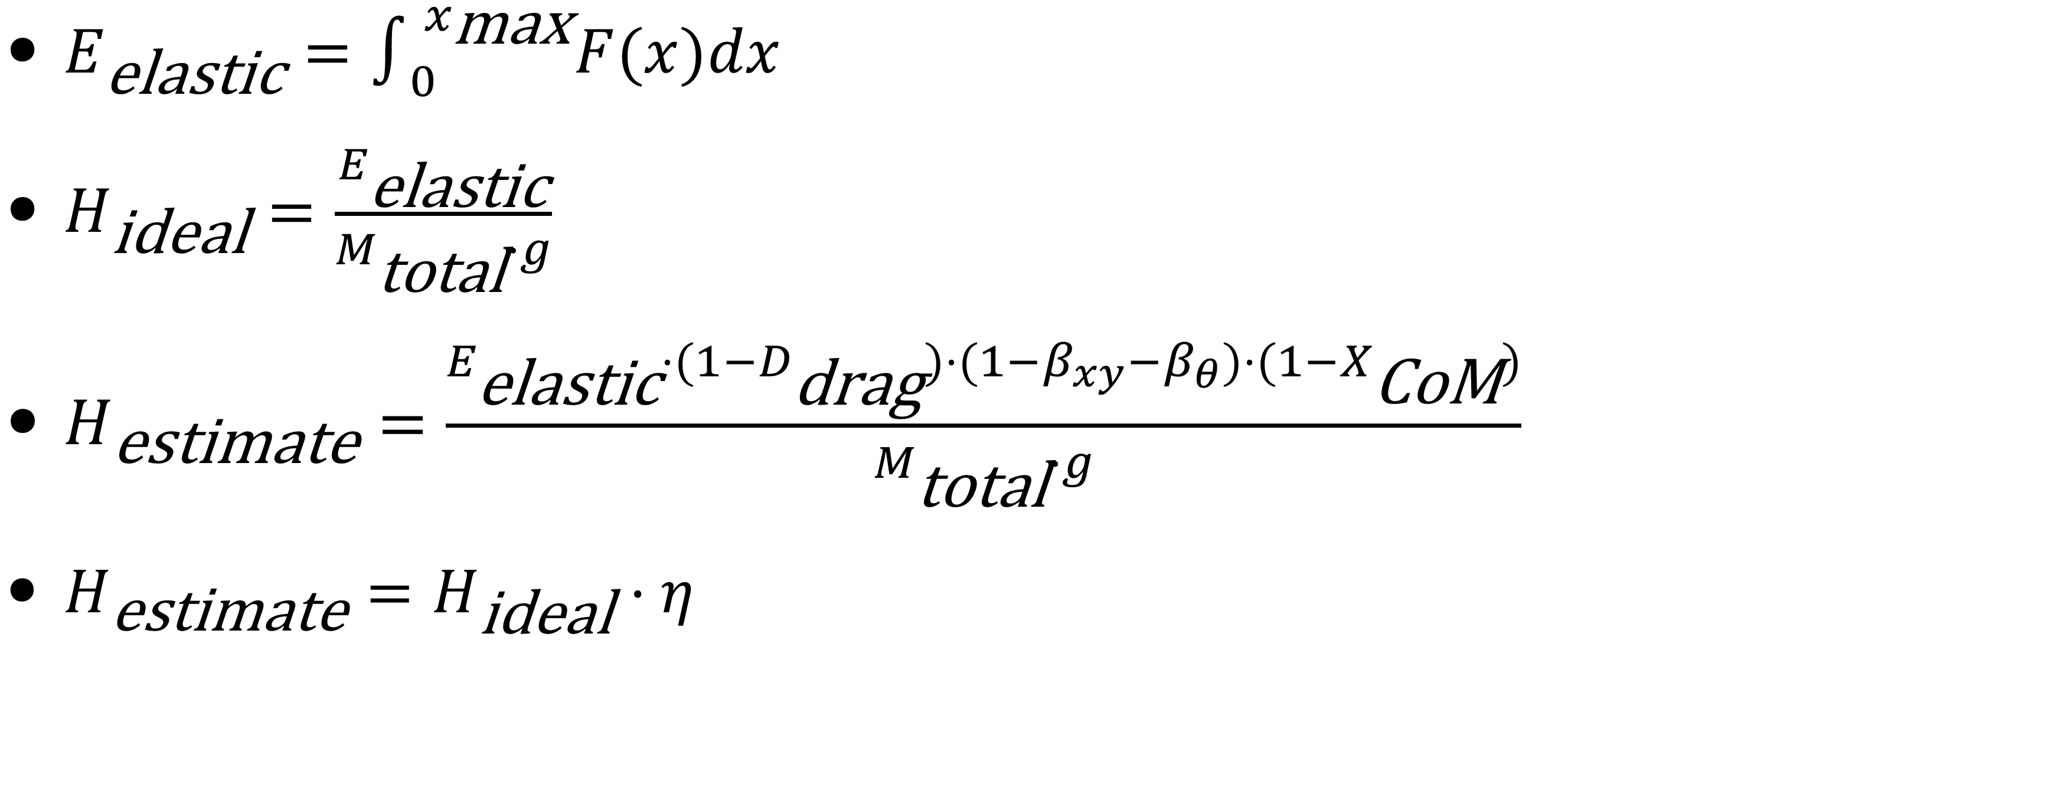
Dynamic Modeling
$E_{\text{elastic}}=∫_{0}^{x_{\text{max}}}F(x)dx$
$H_{\text{ideal}}=\frac{E_{\text{elastic}}}{M_{\text{total}}⋅g}$
$H_{\text{estimate}}=\frac{E_{\text{elastic}}⋅(1−D_{\text{drag}})⋅(1−β_{xy}−β_{θ})⋅(1−X_{\text{CoM}})}{M_{\text{total}}⋅g}$
$H_{\text{estimate}}=H_{\text{ideal}}⋅η$
$$H_{\text{ideal}}$$

Slide 5
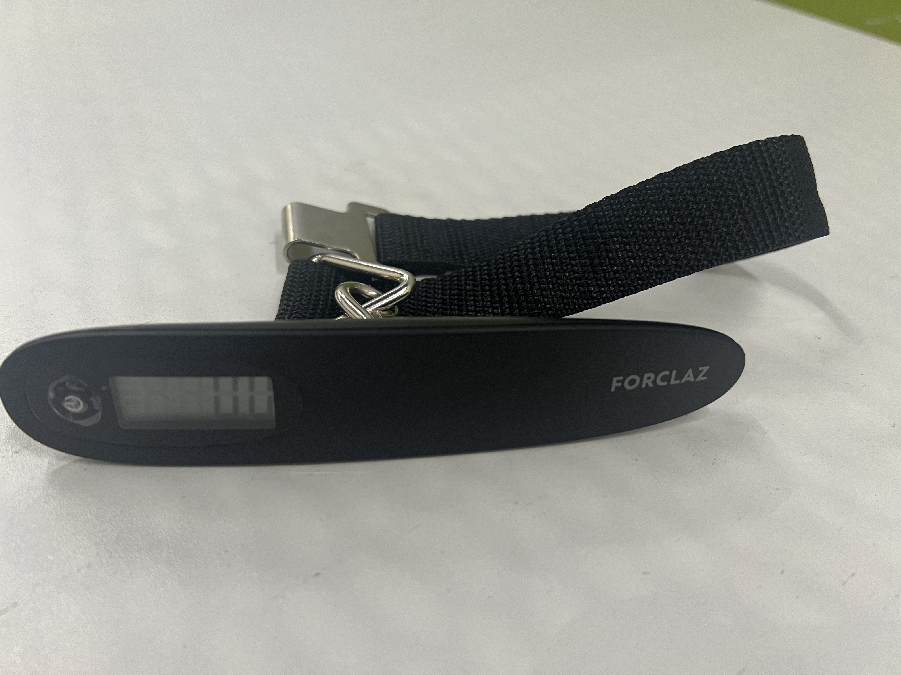
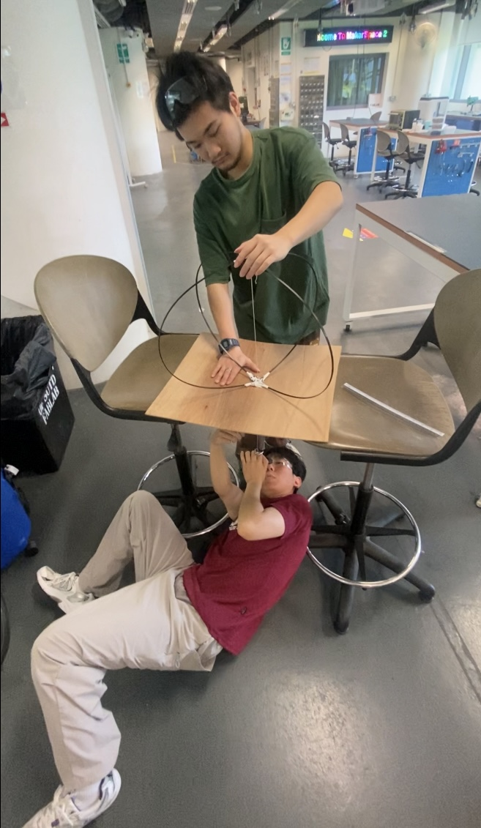
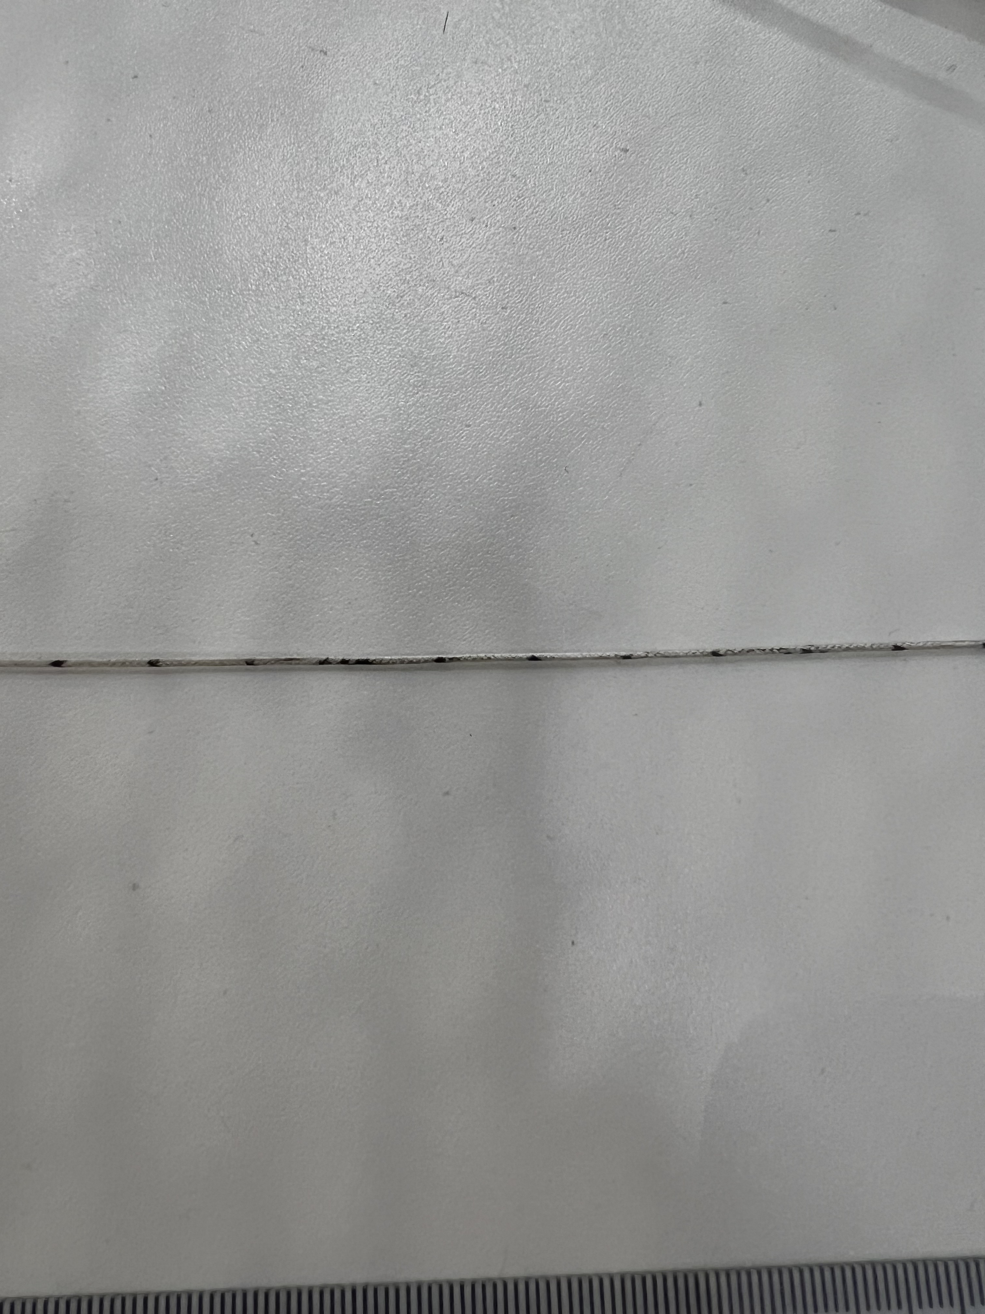
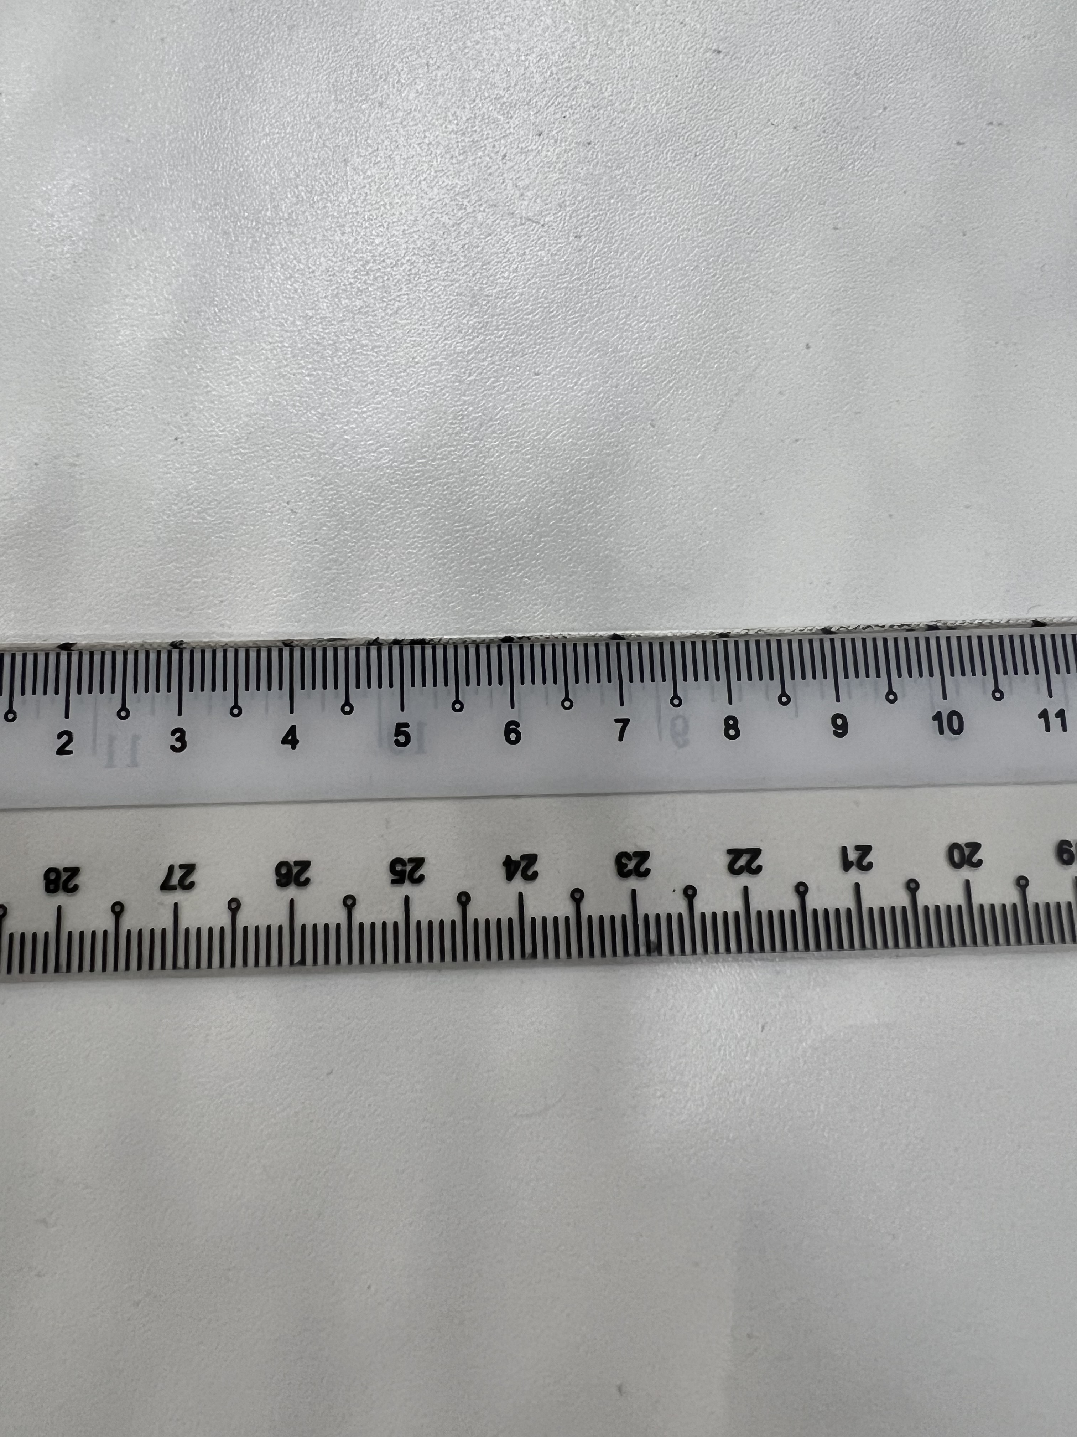
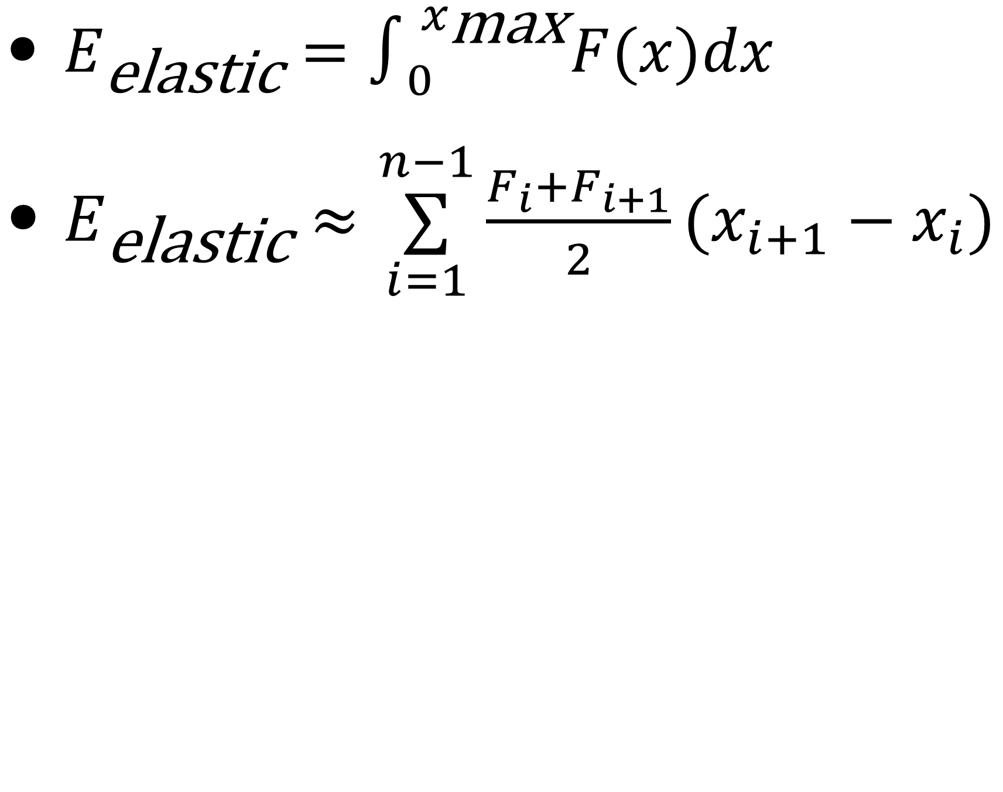
Dynamic Modeling
$E_{\text{elastic}}=∫_{0}^{x_{\text{max}}}F(x)dx$
$E_{\text{elastic}}≈\overset{n−1}{\underset{i=1}{∑}}\frac{F_{i}+F_{i+1}}{2}(x_{i+1}−x_{i})$
Fi
X2
X3
X4
X5
X6
X7
X8
X9
X10
X11
X2
X3
X4
X5
X6
X7
X8
X9
X10
X11

Slide 6
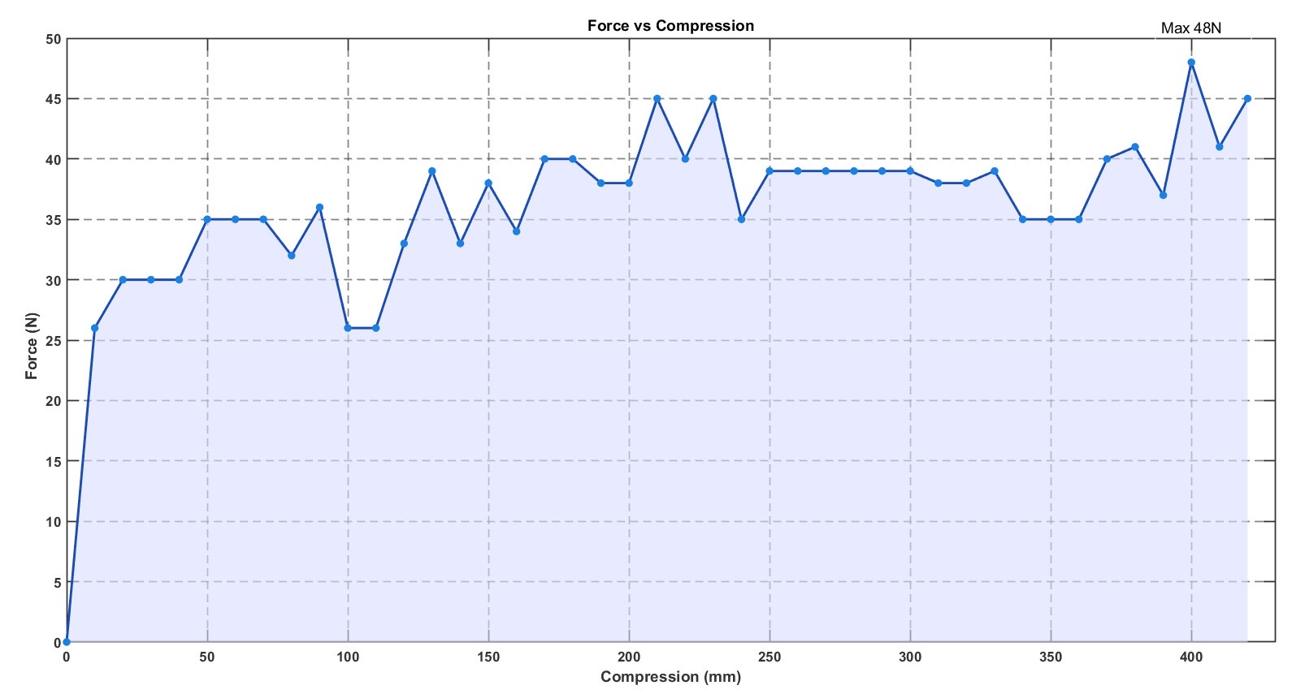
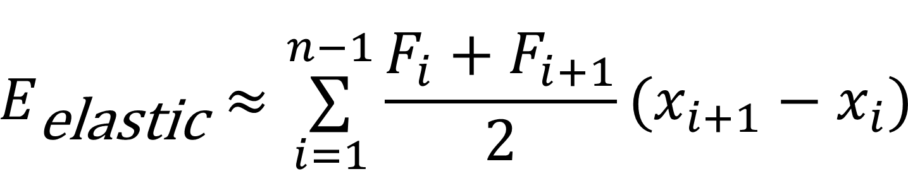
$$E_{\text{elastic}}≈\overset{n−1}{\underset{i=1}{∑}}\frac{F_{i}+F_{i+1}}{2}(x_{i+1}−x_{i})$$

Slide 7
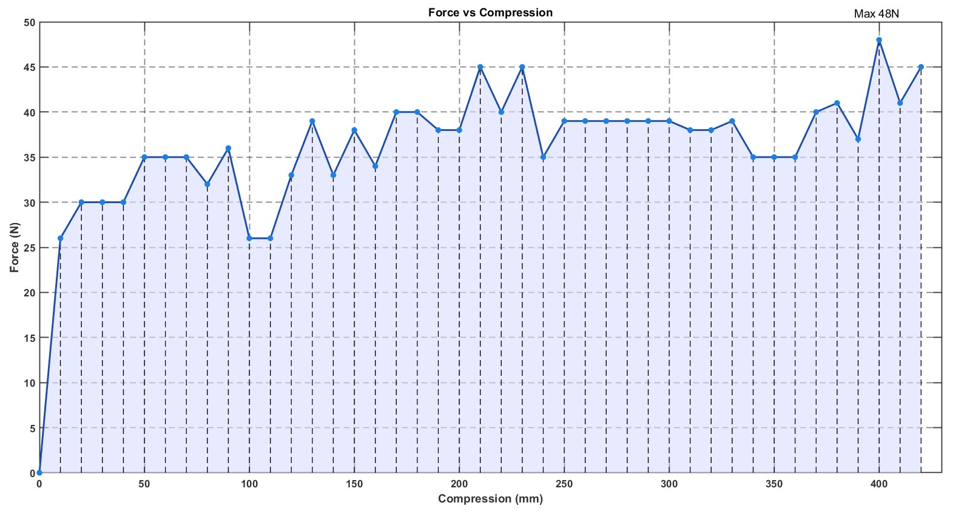
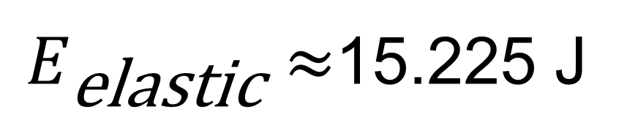
15.225 J
$E_{\text{elastic}}≈$15.225 J

Slide 8
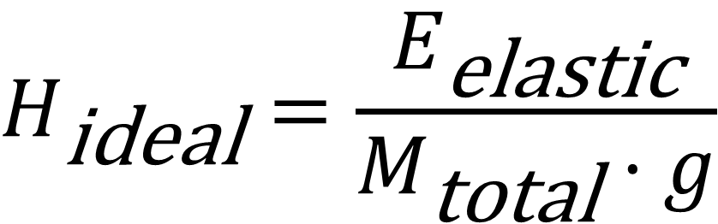
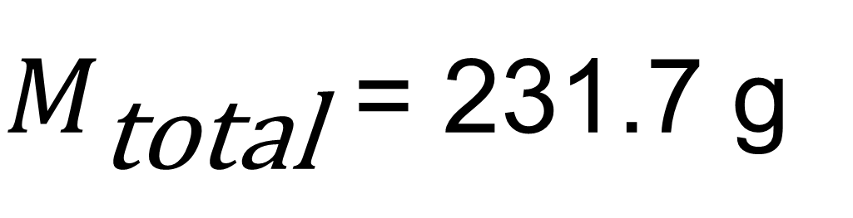
Components | Mass [g] | Amount | Total Mass [g]
Carbon Fiber Jumper | 64.0 | 1 | 64.0
EM Clutch | 23.0 | 1 | 23.0
Micro Gearmotor | 12.0 | 1 | 12.0
Servo Motor | 16.0 | 2 | 32.0
Battery Pack | 1.2 | 8 | 9.6
Arduino Nano 33 Ble Rev2 | 6.1 | 1 | 6.1
Electrical Wires | 15 | 1 | 15
Gliding Wing | 25.0 | 2 | 50.0
Connection Structure | 20.0 | 1 | 20.0
$$H_{\text{ideal}}=\frac{E_{\text{elastic}}}{M_{\text{total}}⋅g}$$
$M_{\text{total}}$ = 231.7 g

Slide 9
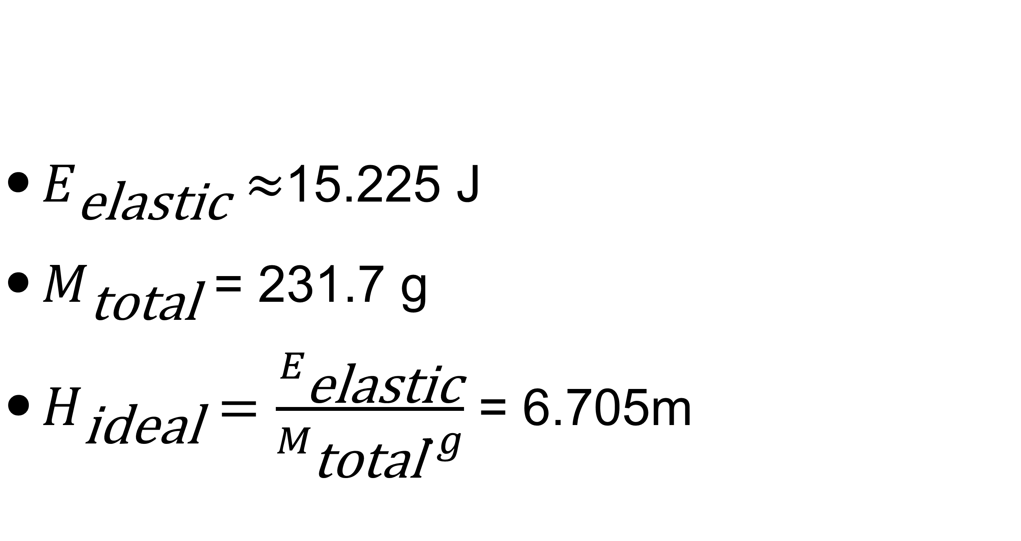
$E_{\text{elastic}}≈$15.225 J
$M_{\text{total}}$ = 231.7 g
$H_{\text{ideal}}=\frac{E_{\text{elastic}}}{M_{\text{total}}⋅g}$ = 6.705m

Slide 10
$$H_{\text{estimate}}=\frac{E_{\text{elastic}}⋅(1−D_{\text{drag}})⋅(1−β_{xy}−β_{θ})⋅(1−X_{\text{CoM}})}{M_{\text{total}}⋅g}$$
$D_{\text{drag}}$: Energy loss factor caused by air resistance.
$β_{xy}$: Energy loss caused by deviation from vertical takeoff angle.
$β_{θ}$: Energy loss factor caused by device’s rotation during the jump.
$X_{\text{CoM}}:$Energy loss factor caused by position of the center of mass.

Slide 11
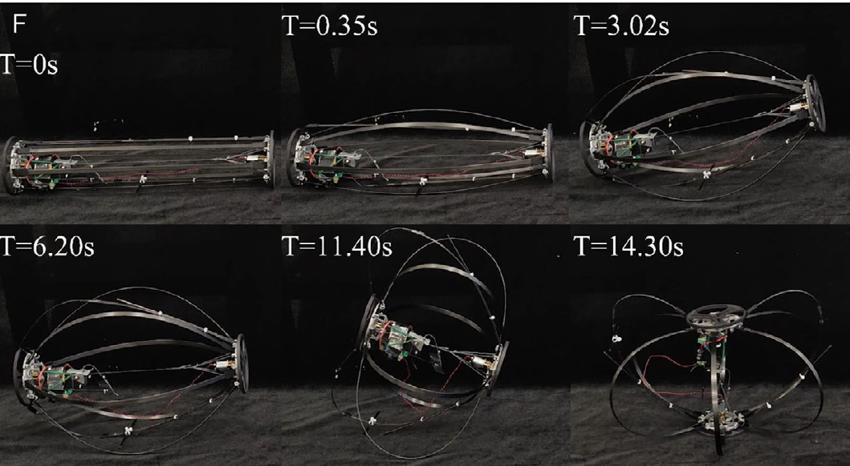
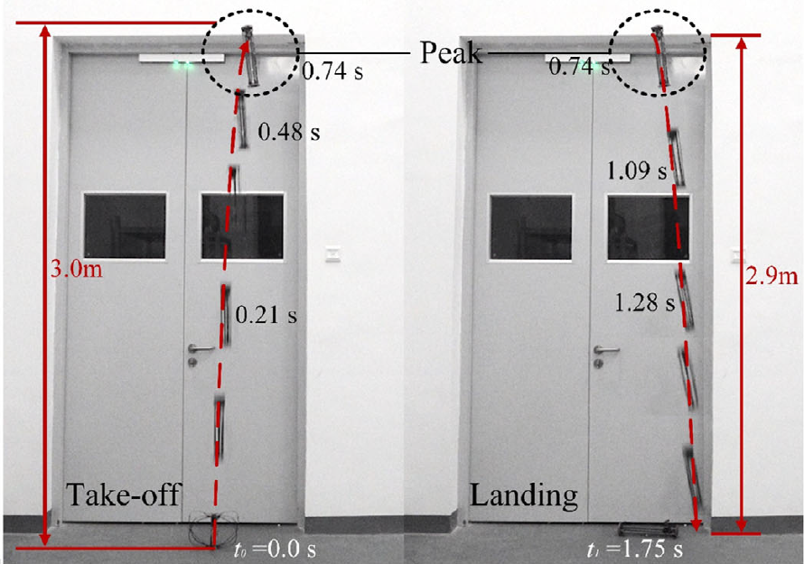
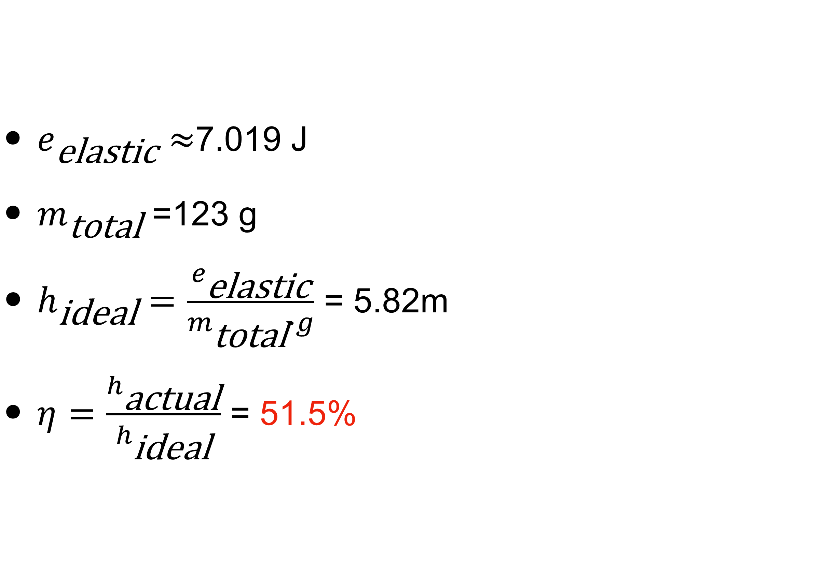
$e_{\text{elastic}}≈$7.019 J
$m_{\text{total}}$ =123 g
$h_{\text{ideal}}=\frac{e_{\text{elastic}}}{m_{\text{total}}⋅g}$ = 5.82m
$η=\frac{h_{\text{actual}}}{h_{\text{ideal}}}$ = 51.5%

Slide 12
$H_{\text{estimate}}=H_{\text{ideal}}⋅η$ = 3.45 m

Slide 13
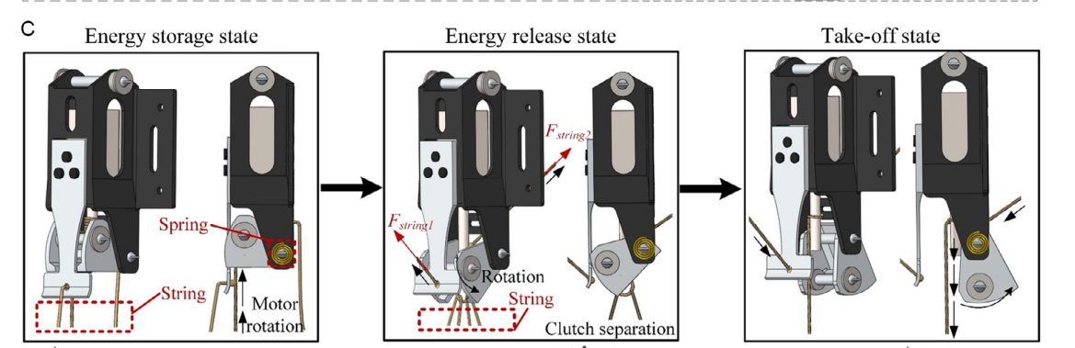
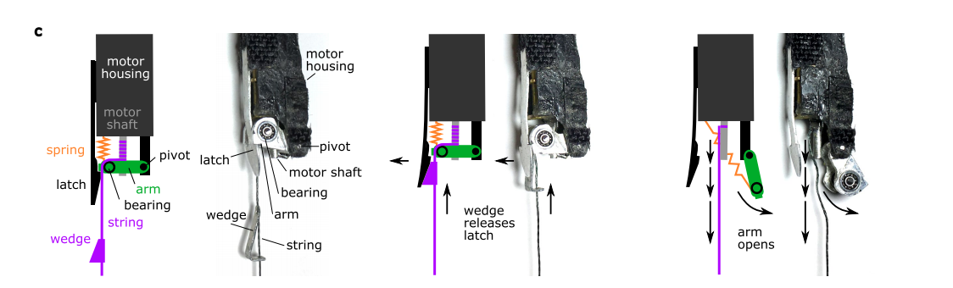
Release Mechanism
Others Only for One Time ！

Slide 14
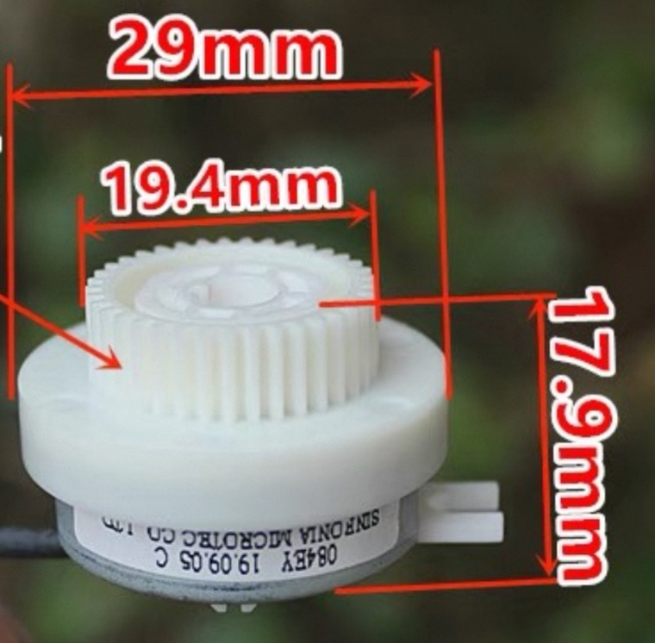
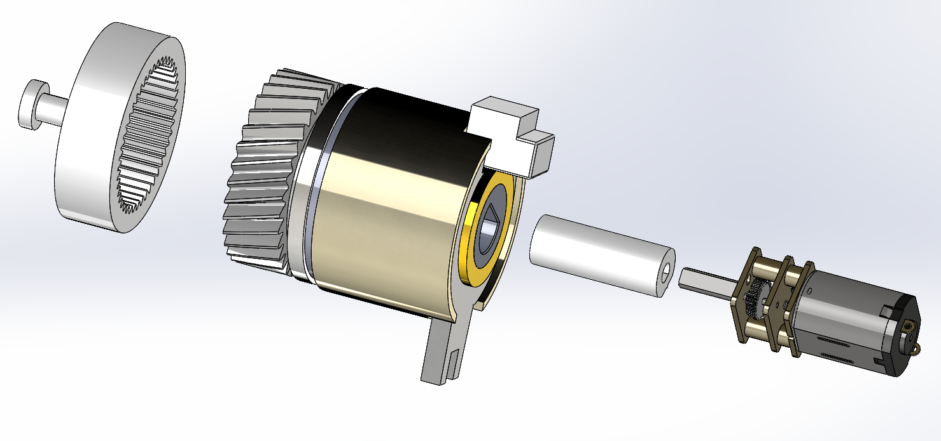

Release Mechanism
We can do many times ！

Slide 15
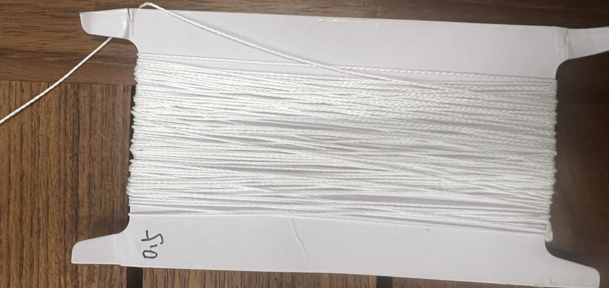
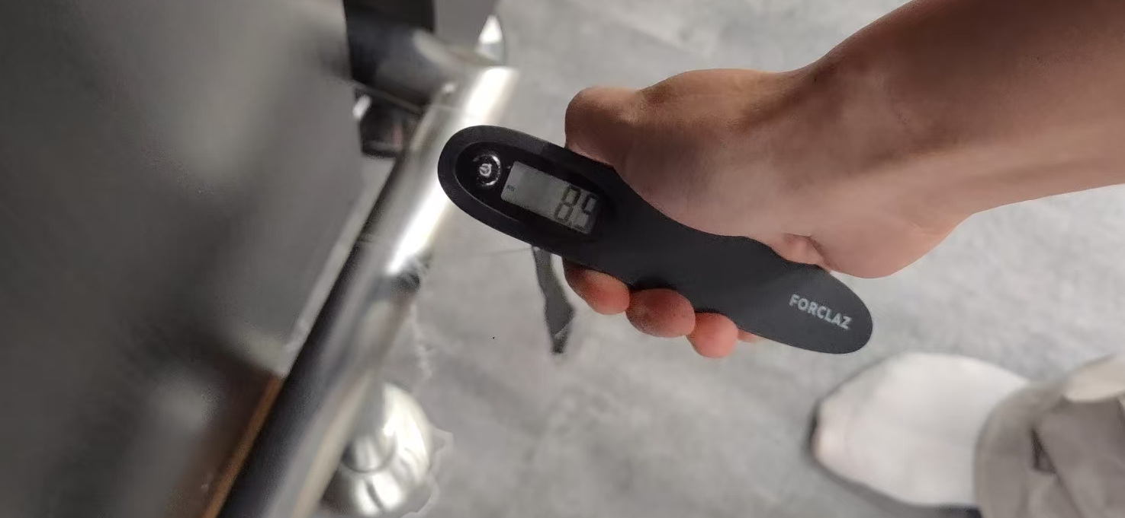
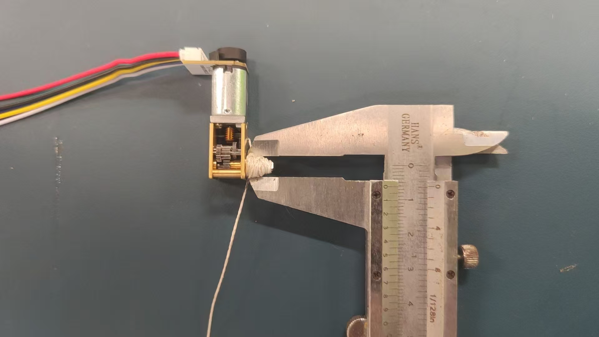
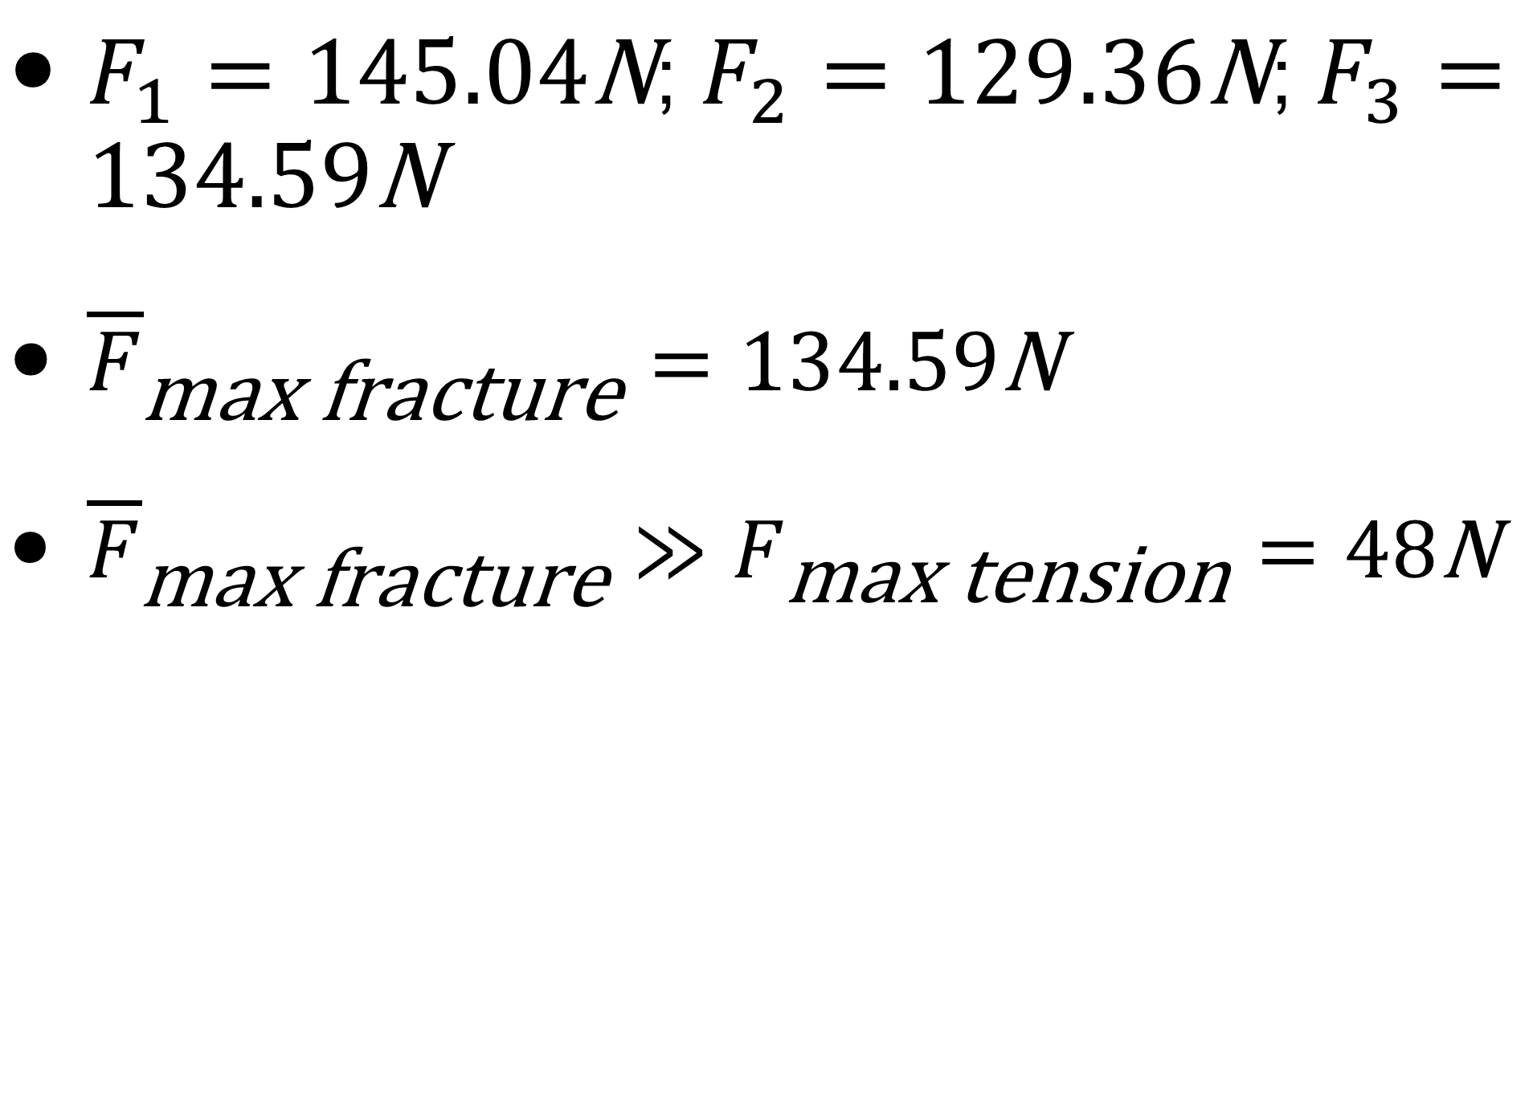
Release Mechanism
$F_{1}=145.04\text{N}$; $F_{2}=129.36\text{N}$; $F_{3}=134.59\text{N}$
${\overline{F}}_{\text{max} \text{fracture}}=134.59\text{N}$
${\overline{F}}_{\text{max} \text{fracture}}≫F_{\text{max} \text{tension}}=48\text{N}$

Slide 16
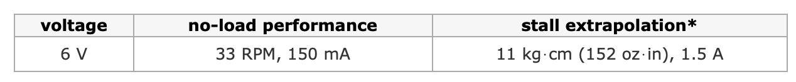
Release Mechanism
$$τ_{\text{motor}}=11\text{kg}⋅\text{cm}≫τ_{\text{max}}=1.23\text{kg}⋅\text{cm}$$

Slide 17
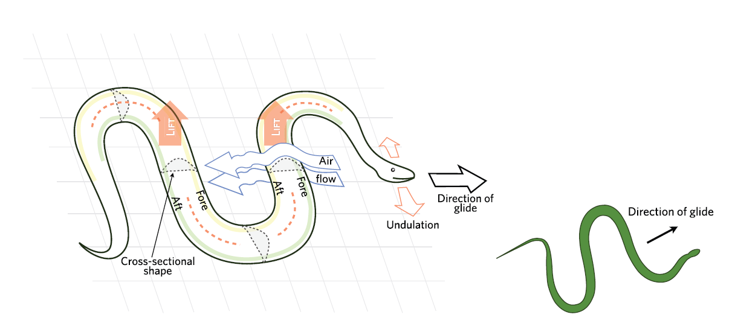
Gliding Module
Solution Selection

Slide 18
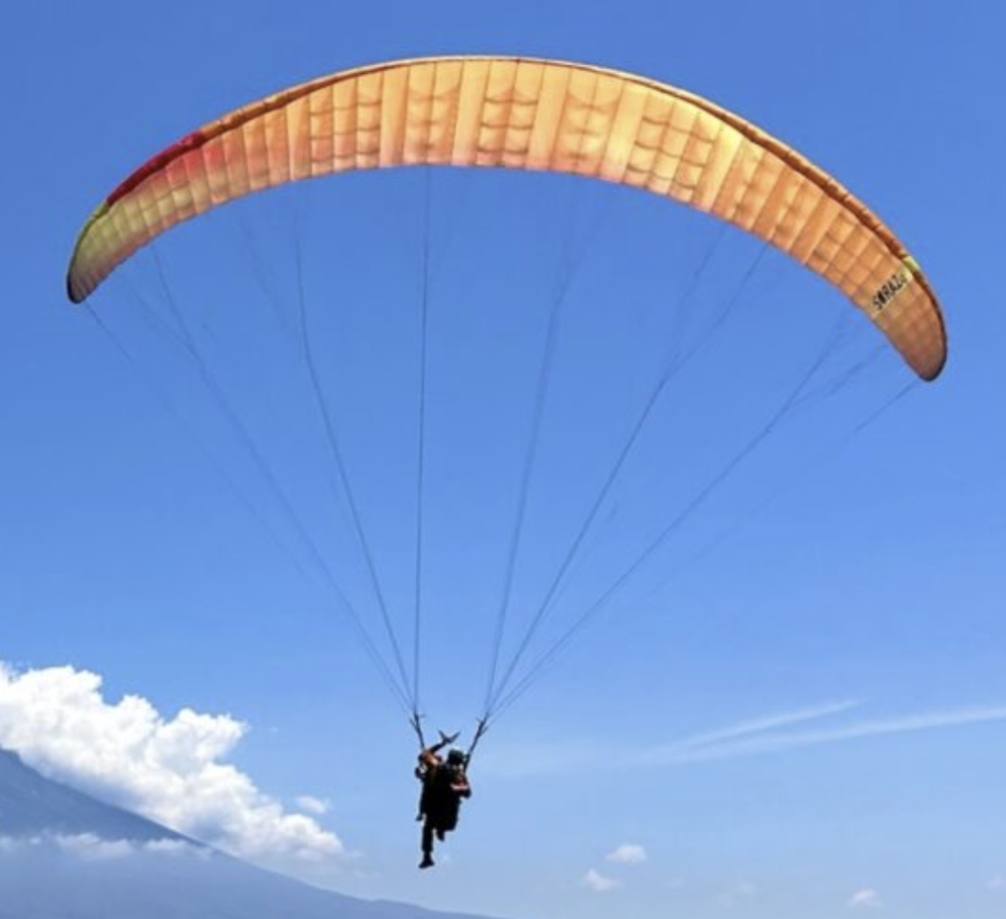
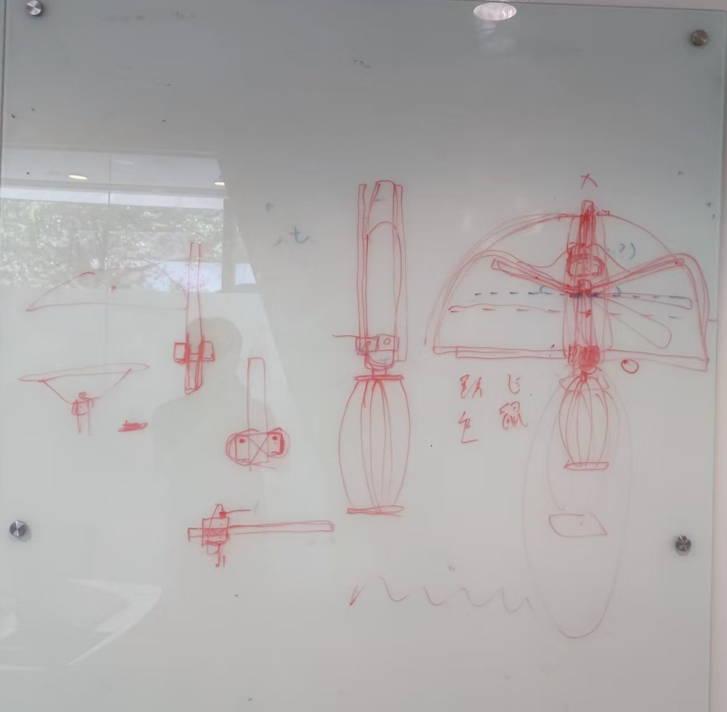
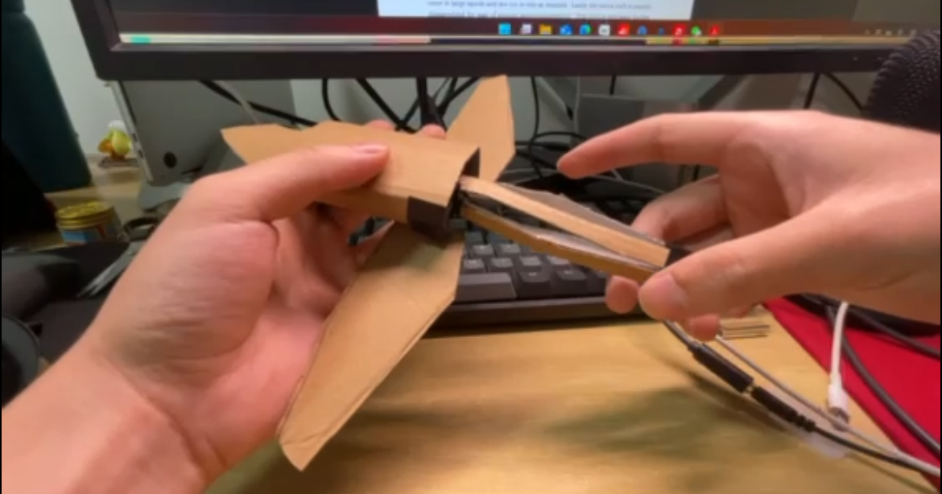
Gliding Module
Solution Selection

Slide 19
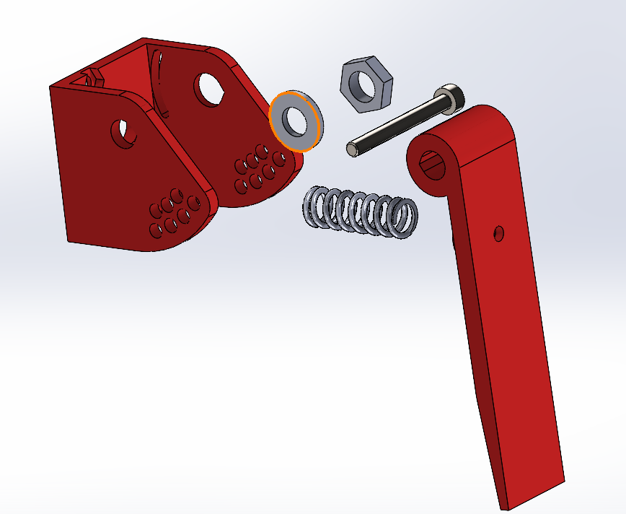
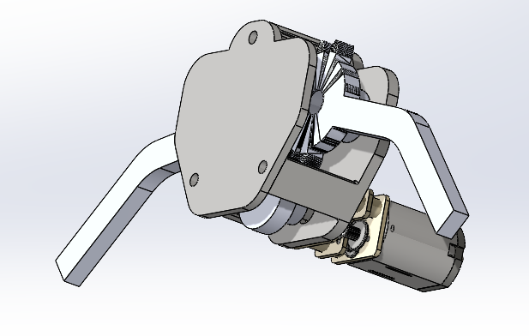
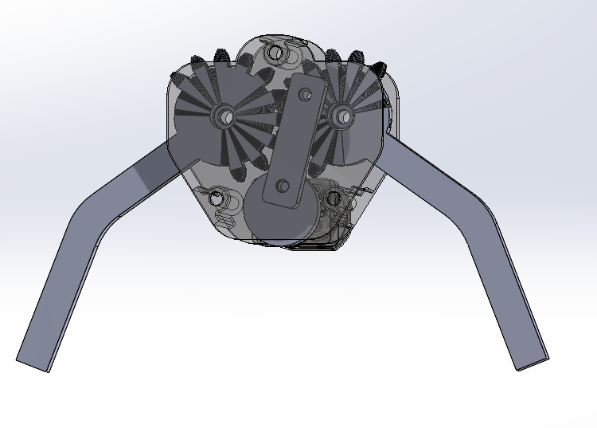
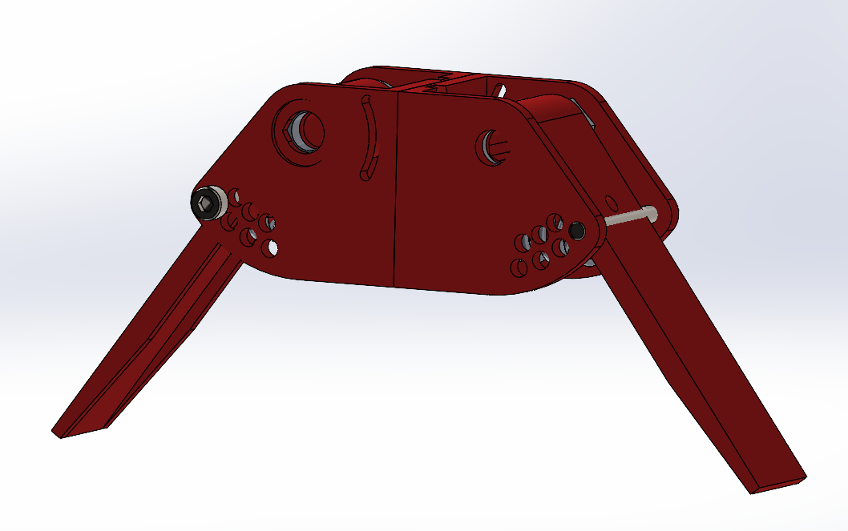
Gliding Module
Solution Selection

Slide 20
Time Table
Week | Topic/Activity | Notes
7 | Recess
8 | Fabrication, Testing, and Iterative Optimization of the Jumping Module
9 | Design and Modeling of the Gliding Module(ncluding Electronic Systems, Mechanical Structures, and Associated Subsystems)
10 | Fabrication and Experimental Testing of the Gliding Module
11 | Integration, Assembly, and System-Level Testing of the Combined Jumping and Gliding Modules (encompassing Electronics and Mechanical Structures)
12 | Comprehensive System Testing and Data Analysis
13 | Final Prototype Testing, Data Acquisition, Analysis, and Academic Paper Preparation | Final Presentation & Demonstration

Slide 21
Motivation
Do something cool, something no one ever done before !
Always exploring !

Slide 22
Thank you !

